Slide 1
Democracy

Slide 2
demos = people
kratia = rule
democracy = people’s rule
“Our constitution is called a democracy because power is in the hands not of a minority but of the whole people.”
Thucydides 2.37

Slide 3
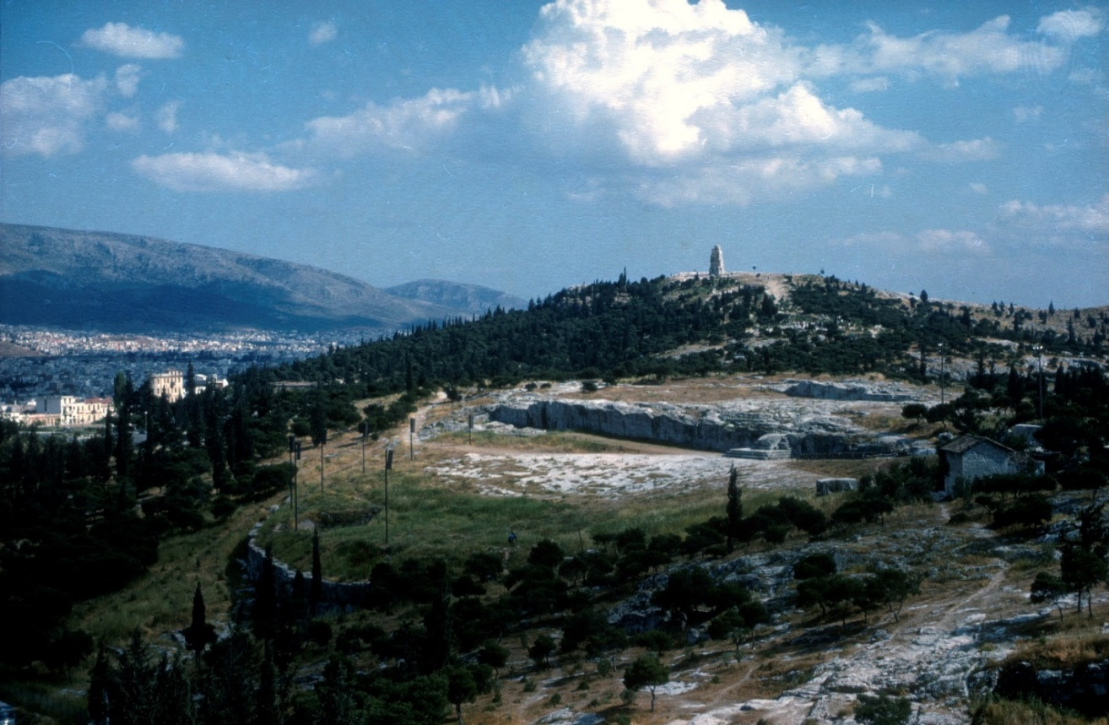
Houses of Parliament – representative democracy
Citizen Assembly – direct democracy

Slide 4
Who could vote in ancient Athens?
Men
Women
Slaves
Foreigners
?
?
?
?

Slide 5
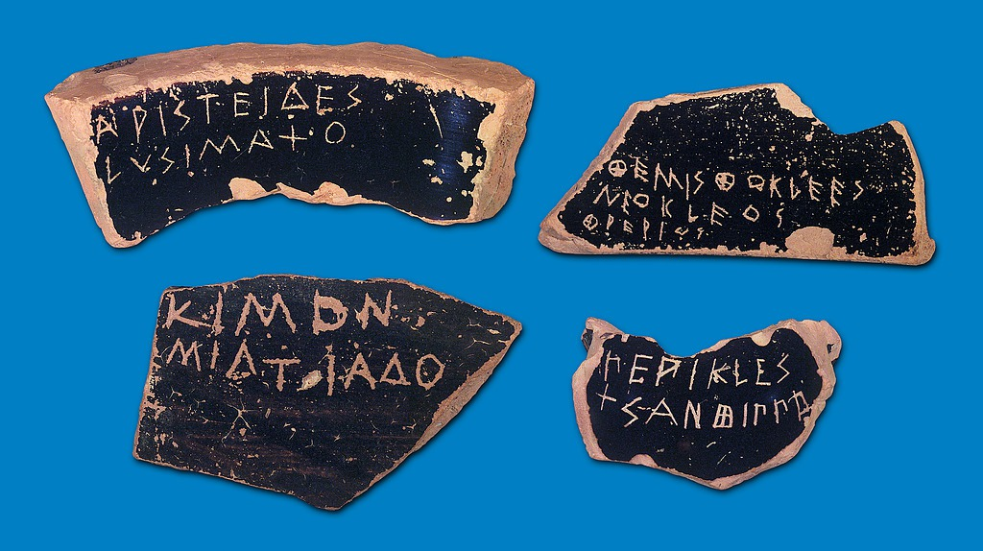
Lots of ostraka (or a single ‘ostrakon’)

Slide 6
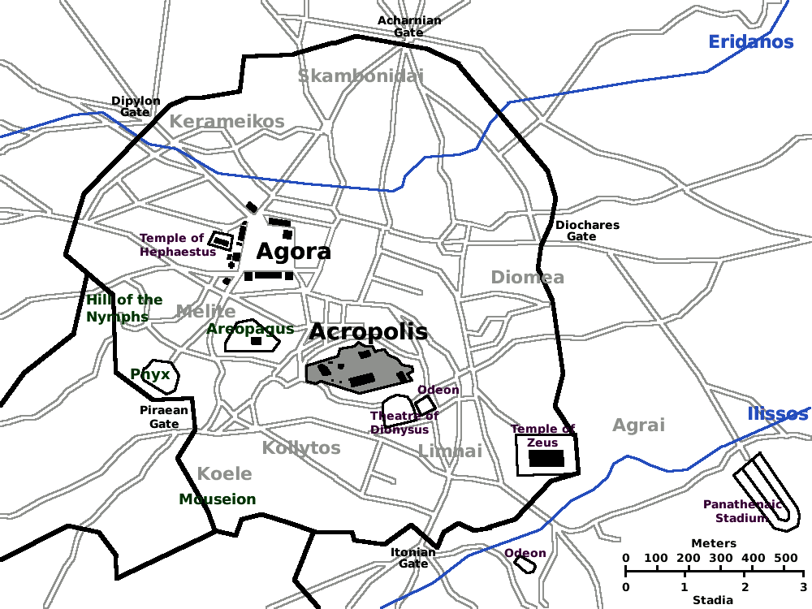
The Pnyx

Slide 7
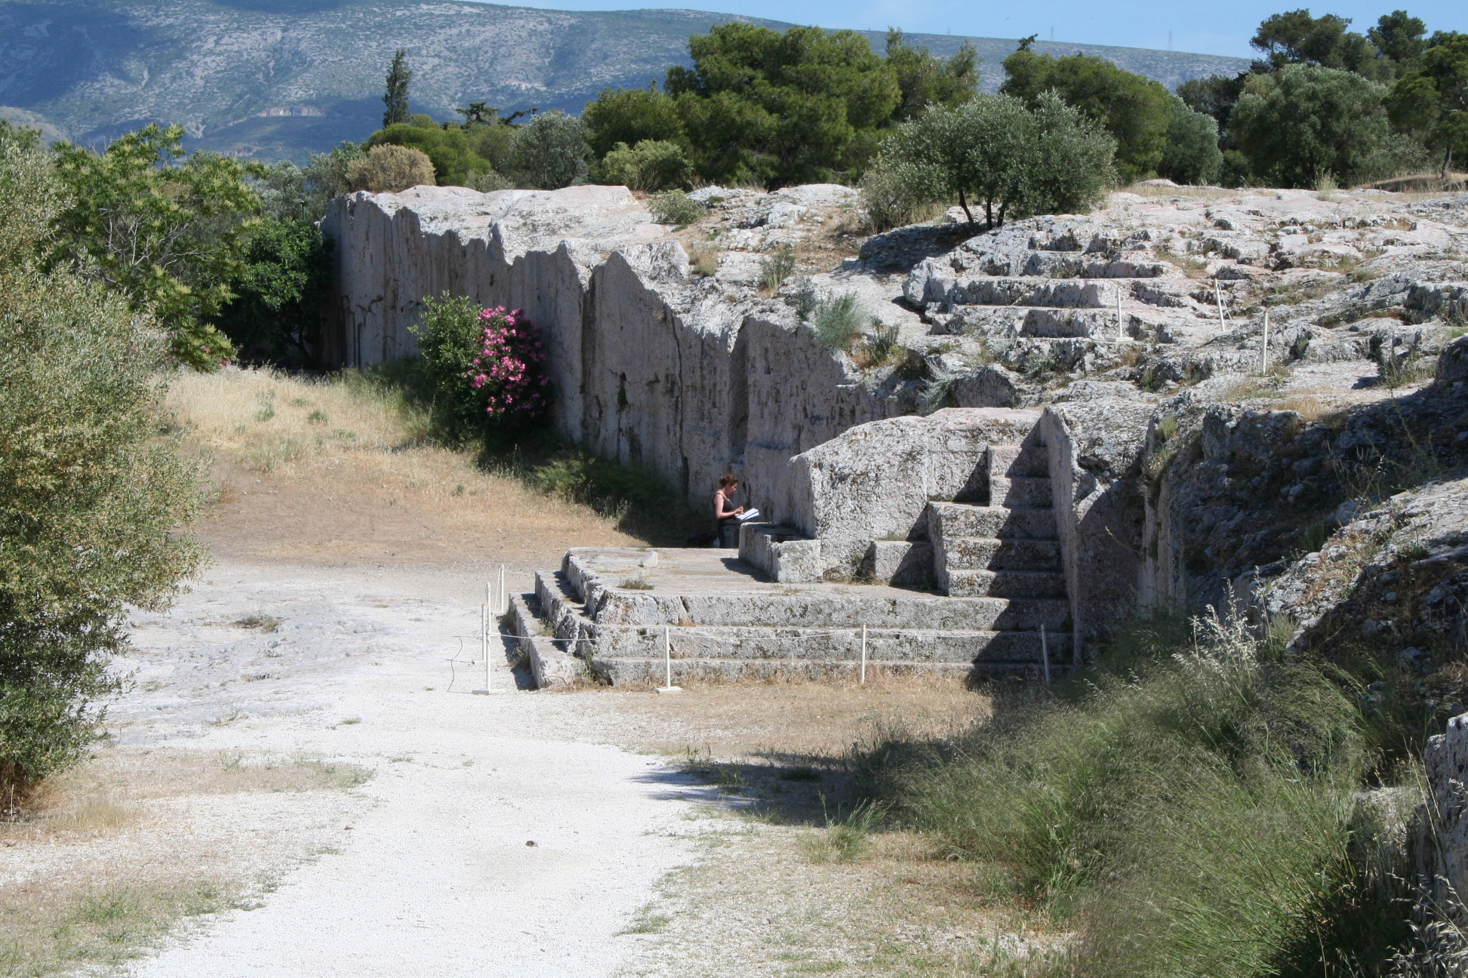
The Bema

Slide 8
Law Court
Reconstruction of a Law Court in the Agora (Market-Place)

Slide 9
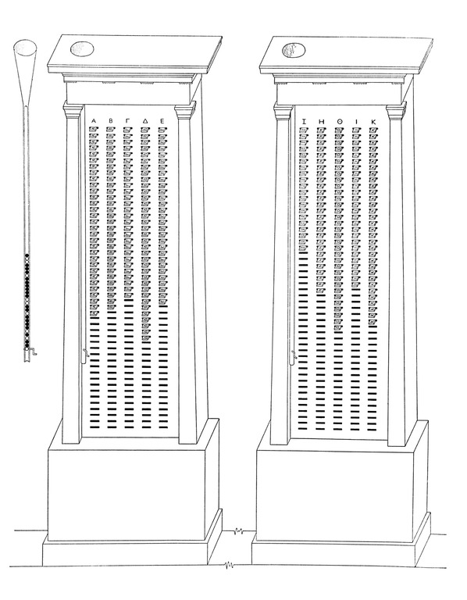
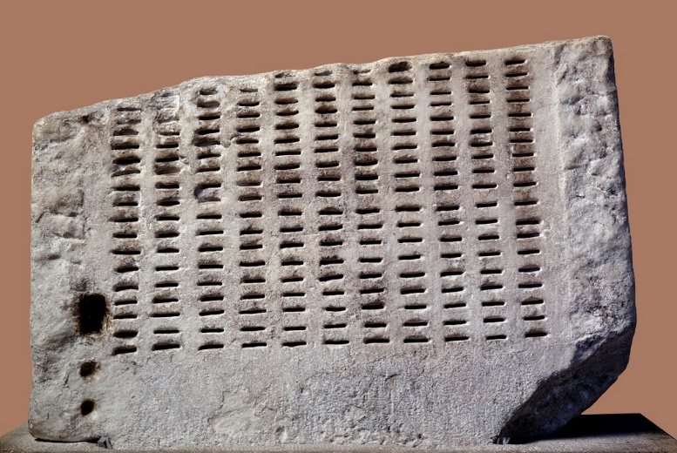
Allotment Machine Reconstruction
Part of an Ancient Allotment Machine

Slide 10
Pinakion

Slide 11
Ballots

Slide 12
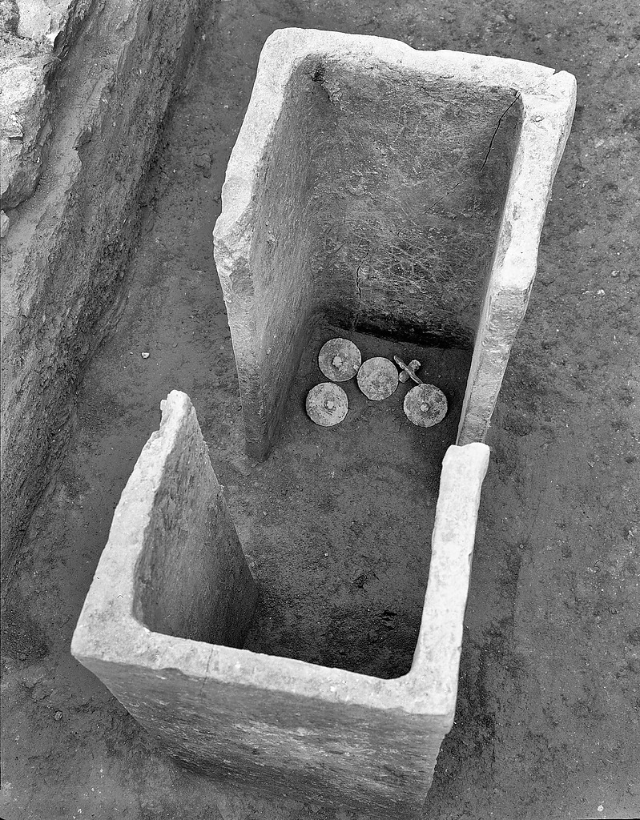
Ballot Box

Slide 13
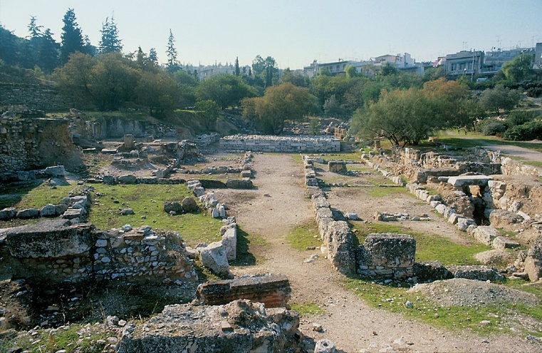
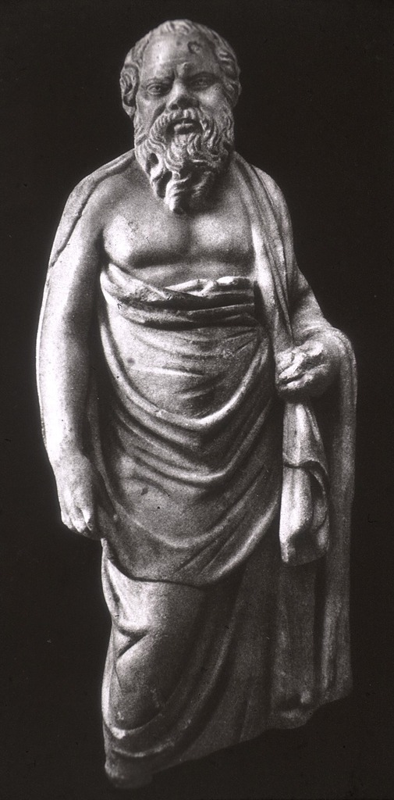
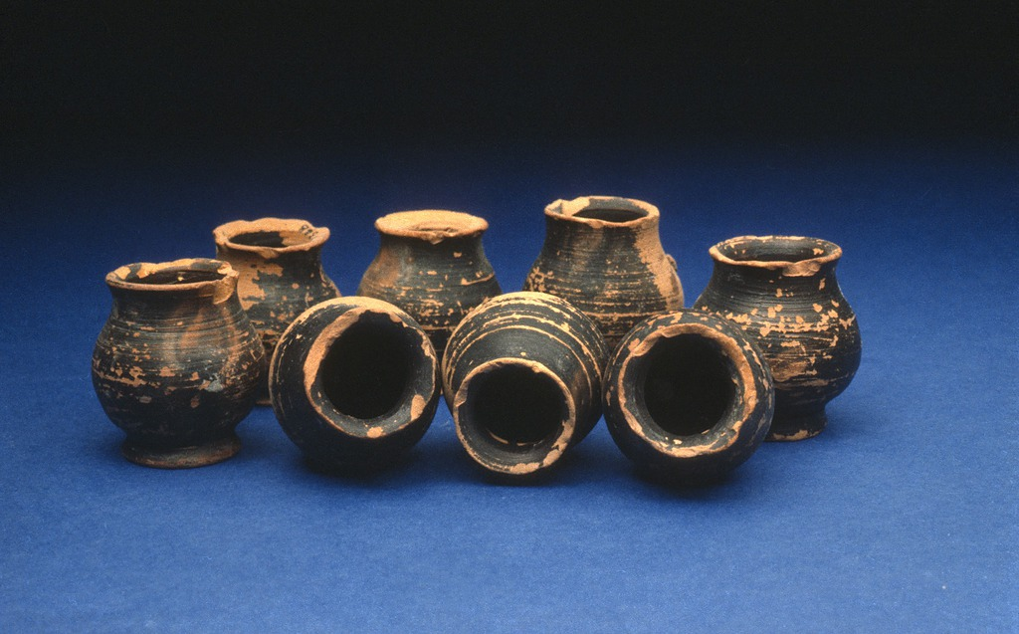
Socrates
The State Prison
Medicine Bottles from the State Prison

